Slide 1
SQL Portfolio-Part 1
Loan Portfolio Analysis by Income, DTI & Credit Tiers

Slide 2
Introduction
Objective of Analysis
Examine loan portfolio across DTI Tiers × Income Brackets × Credit Tiers
Identify patterns, risks, and inconsistencies leading to defaults
Provide data-driven insights for better credit decision-making

Slide 3
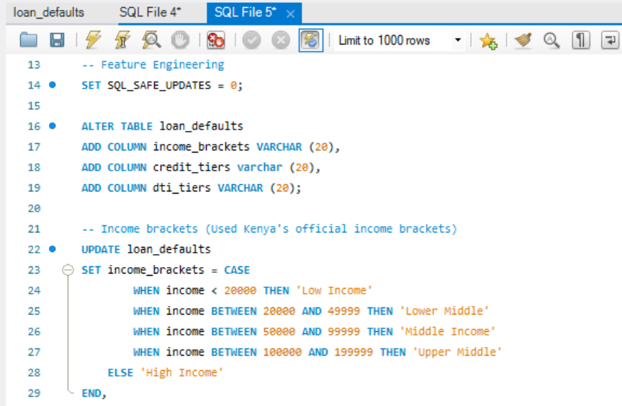
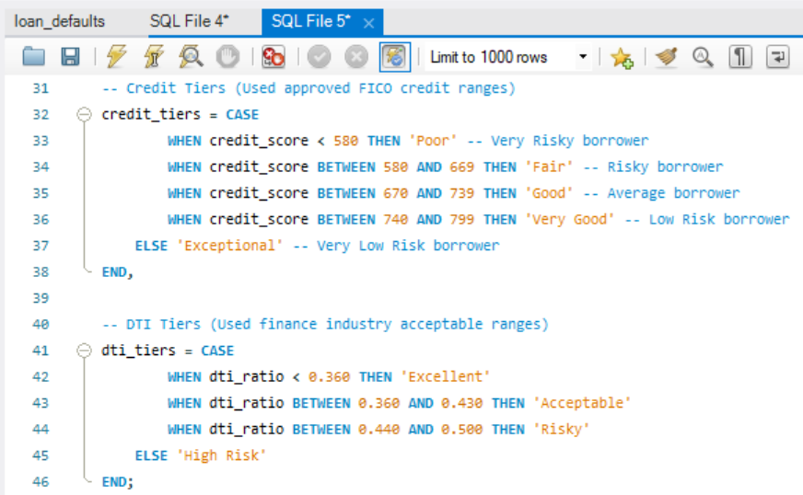
Feature Engineering: Creating derived columns
Income Brackets-grouped borrower income into ranges
DTI Tiers-categorized debt-to-income ratios
Credit Tiers- categorized credit scores
Notes:
Note: These columns form the basis for all subsequent analysis questions

Slide 4
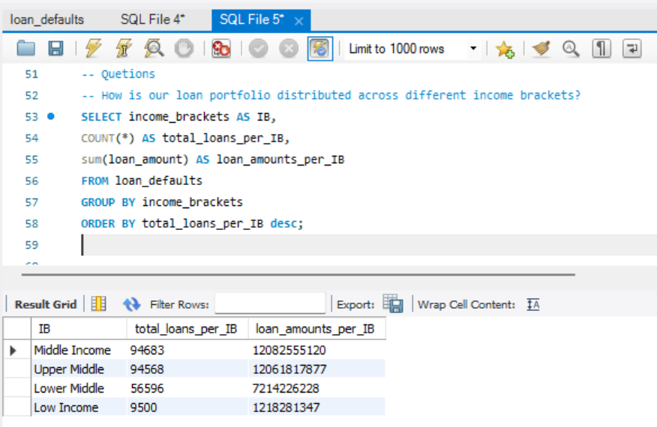
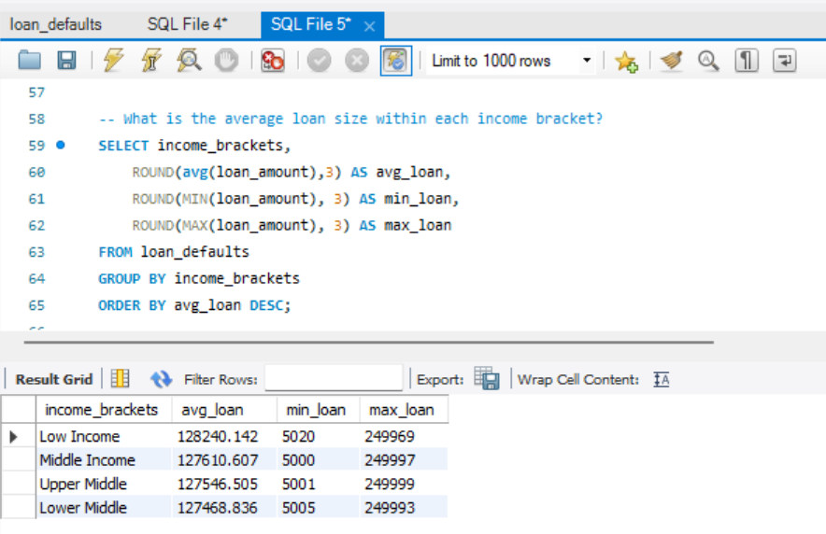
Portfolio Distribution: Who are our clients?
How is our loan portfolio distributed across different income brackets?
What is the average loan size within each income bracket?

Slide 5
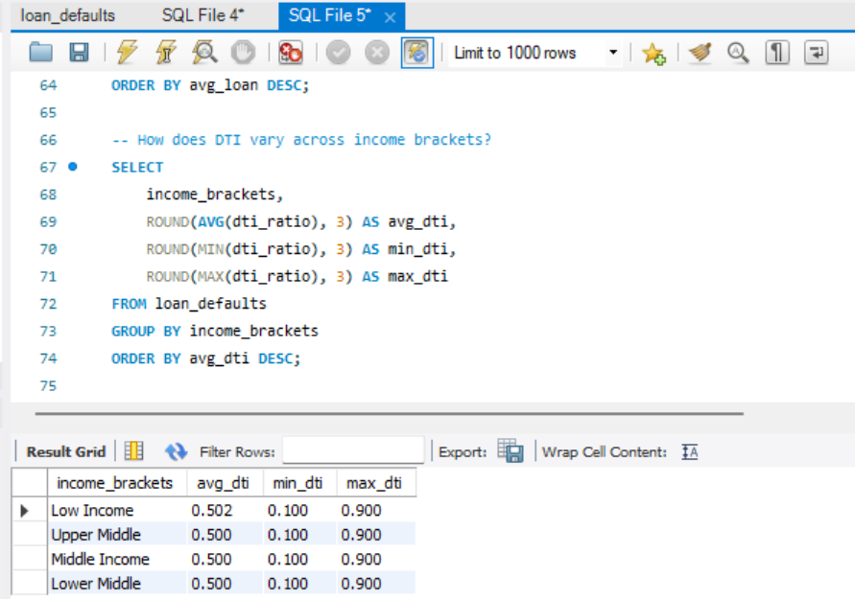
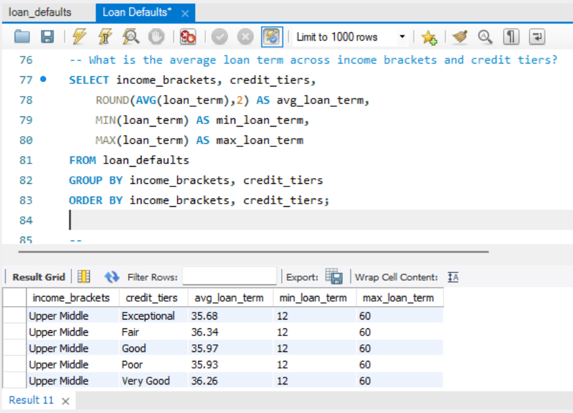
Credit & Risk Profile: How risky are they?
How does DTI vary across income brackets?
What is the average loan term across income brackets and credit tiers?

Slide 6
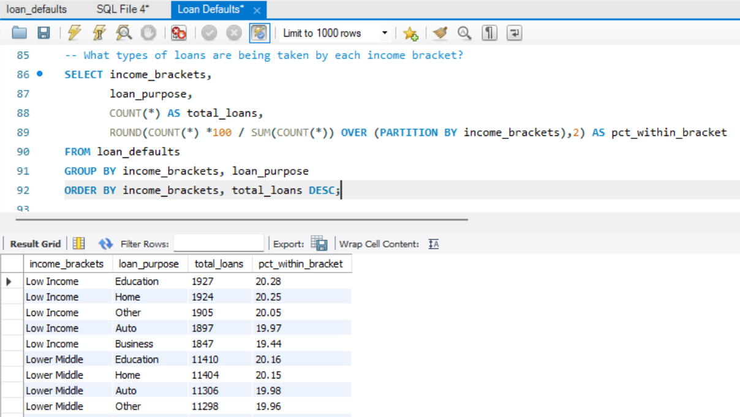
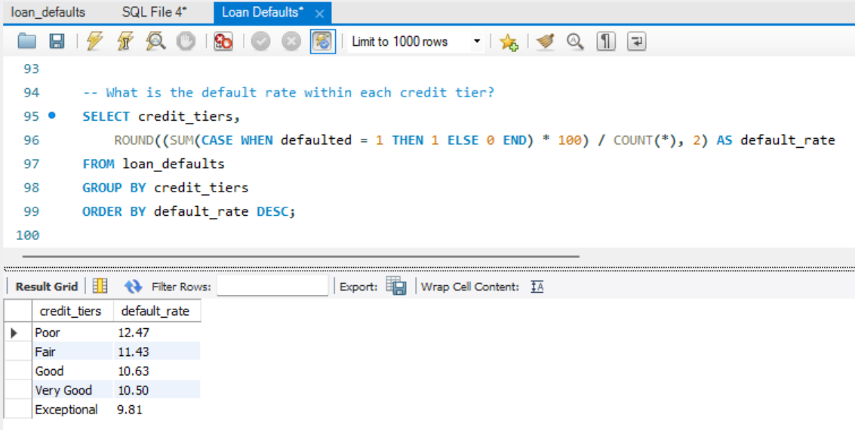
Credit & Risk Profile: How risky are they?
What types of loans are being taken by each income bracket?
What is the default rate within each credit tier?

Slide 7
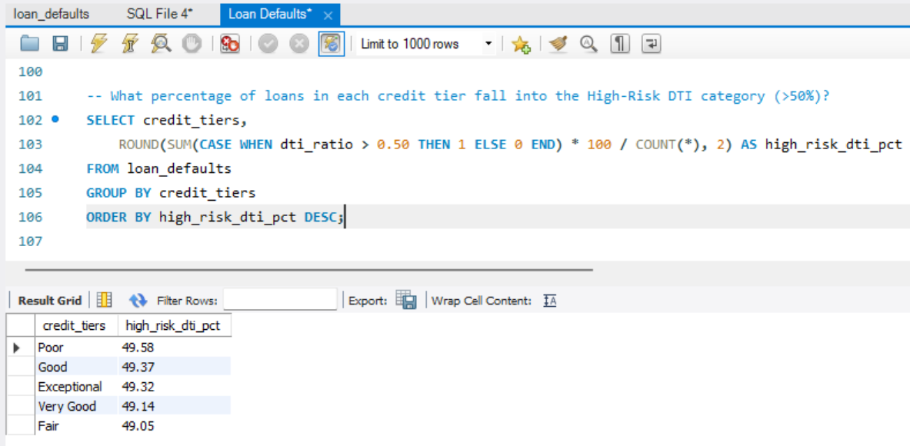
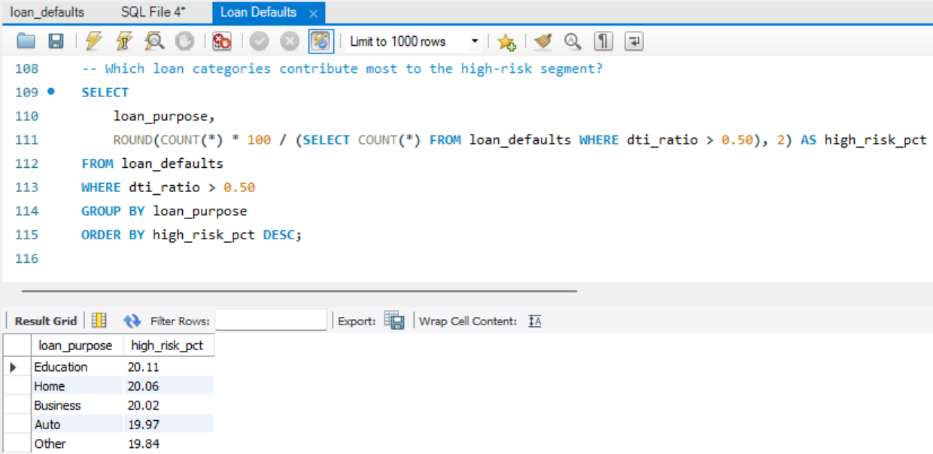
High Risk Segments: Where are the red flags?
What percentage of loans in each credit tier fall into the High-Risk DTI category (>50%)?
Which loan categories contribute most to the high-risk segment?

Slide 8
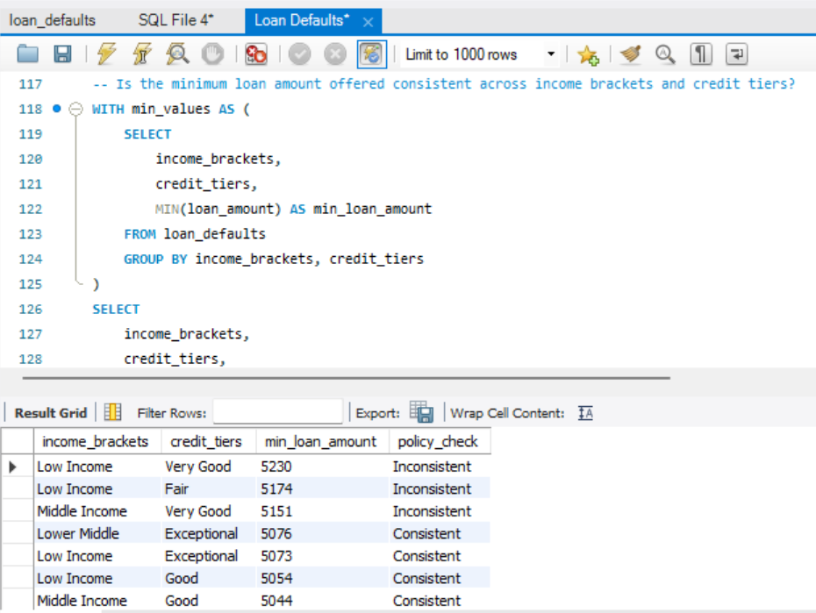
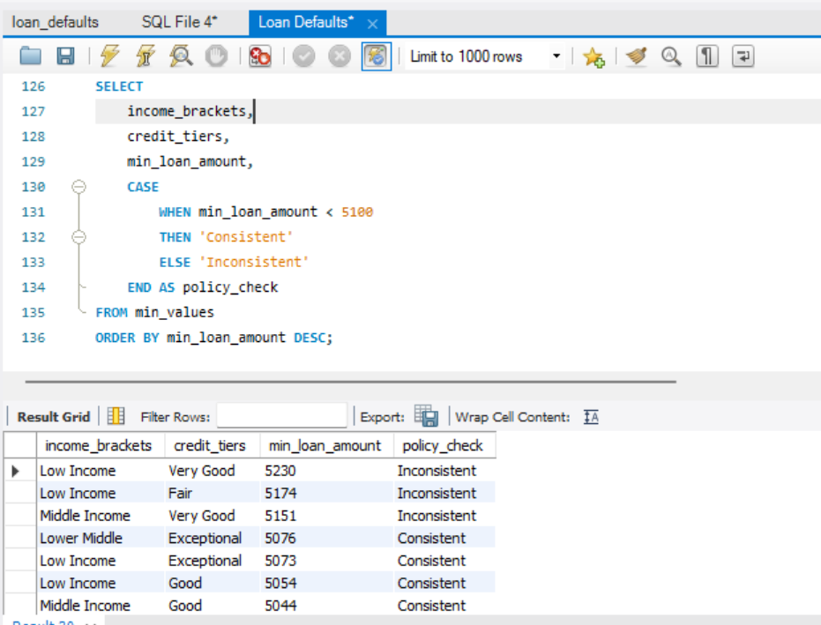
Policy & Consistency Check: Are we applying rules fairly
Is the minimum loan amount offered consistent across income brackets and credit tiers?
Code Part 2

Slide 9
Risk & Portfolio Insights
DTI & Risk - lower-income brackets have higher average DTI. High-Risk DTI (>50%) loans concentrated in weaker credit tiers.
Default rates - higher in low-income & weak credit tiers. Stronger tiers maintain lower default rates.
Loan terms & amounts - shorter terms in high-risk groups, longer terms in stronger profiles.
Some loans issued below policy minimum (<6000) which shows policy inconsistencies.
Loan purposes vary across income brackets, affecting repayment behavior.

Slide 10
Risk Management Recommendations
Tighten risk controls – apply stricter criteria for high DTI & weak credit borrowers
Enforce policy consistently - ensure adherence to minimum loan amount thresholds
Targeted monitoring - flag and track high-risk segments (>50% DTI)
Segmented lending - loan terms/products by risk profile and balance exposure across income brackets & credit tiers

Slide 11
THE END

